Slide 1
What does it mean to think historically

Slide 2
Vesna Kostić, history teacher
Serbia, Belgrade
Elementary school “Jovan Dučić”

Slide 3
The historical landmarks about region
Prehistoric sites located in today’s Serbia are from Mesolithic archaeological site (Lepenski vir, around 7000 BC, reaching its peak between 5300-4800 BC) and Vinča from Neolithic archaeological culture dated to the period 5500-4500 BC.

Slide 4
The historical landmarks about region
The Paleo-Balkan tribes evolved in the 2nd and 1st millennia BC
From 1st century BC until Slavic invasions, the region was under Roman rule (17 Roman Emperors were born in what is now Serbia)

Slide 5
The historical landmarks about Serbia
6th century AD - The Slavic settlements in the Balkans, the territories governed by the Byzantine Empire
9th century – The Christianisation and literacy beginning out of which the First Serbian Principality of the Vlastimirovići emerged

Slide 6
The historical landmarks about Serbia
1217. Serbian realm evolved into a Kingdom by the king Stefan Nemanjić and then in an Empire by the tzar Dušan Nemanjić (1345)
1459. The Ottomans conquer Serbia (several minor or unsuccessful revolts took place against Ottoman rule)

Slide 7
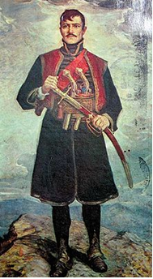
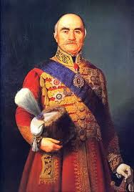
The historical landmarks about Serbia
1804. Serbian Revolution (leading by Karadjordje Petrović at first and later by Miloš Obrenović)
1878. liberation of Serbia

Slide 8
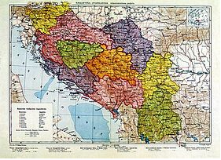
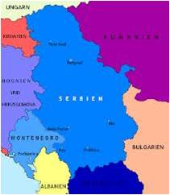
The historical landmarks about Serbia
1918. Yugoslavia was established as union of South Slavic nations
1991-1999. disintegration of Yugoslavia and civil war
2006. Serbia exists as an independent country

Slide 9
The main aims of History Curriculum in Serbia
-Acquisition of humanistic education and development of historical consciousness.
-Historical understanding of space and time, historical events, phenomena and processes and roles of prominent figures in the past, too.
-Understanding of multiculturalism, tolerance and culture of argumentative dialogue.

Slide 10
The main aims of History Curriculum in Serbia
-Improving the skills and competencies necessary for life in today’s society.
-Development of individual and national identity, acquisition and expansion of knowledge and the formation of attitudes necessary for understanding the modern world (in national, regional, European and global scale), the development of critical and creative thinking, the ability for students to express their own views.

Slide 11
The History Curriculum in classrooms of mixed abilities and diverse backgrounds
-The History Curriculum promotes historical understanding so that students learn about the history of different peoples, cultures and religions.
-Students acquire knowledge that people who live in one country have a common heritage, and that such understanding is an advantage.
-They develop individual and national identity.

Slide 12
The History Curriculum in school
-We promote tolerance and concern for each individual through talks and discussions in class.
-Students write the essays of famous people from diverse backgrounds, who have distinguished themselves through their work. Also, students prepare genealogies of their families, in order to better understand the origins of their families.

Slide 13
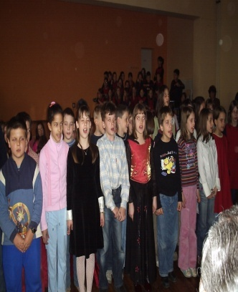
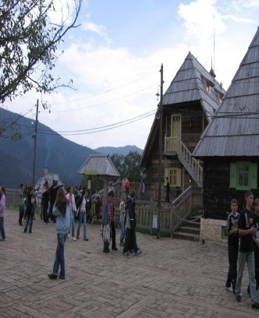
The History Curriculum in school
-Students take part in extracurricular activities according to their abilities and background (by working in students’ parliament, in preparation for school performances and students’ excursions).
-In the museums students visit exhibitions that are supposed to make them think about their own position and feel the position of those who are different from them.

