Slide 1
Dalina Ubartaite Vingiene
Kaunas adults’ educational centre

Slide 2
My presentation
I graduated from Vilnius university in 1990 and received a speciality of a historian.
The university of Vilnius was established in 1579;
Today I am a teacher of history.

Slide 3
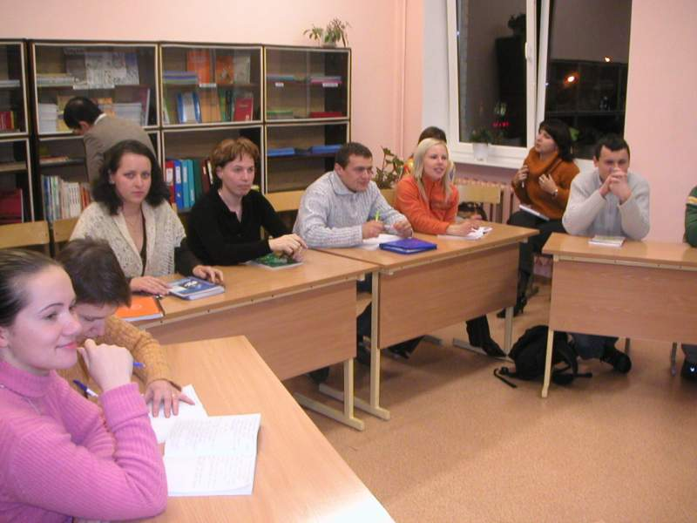
My school
I work in Kaunas adults’ educational centre;
There are three profiles of learning: humanitarian, real, and technological;
Here pupils learn from eighteen years old to over thirty.
The adults finishing the school receive the basic background.

Slide 5
Lithuania in the World

Slide 6
History facts
Lithuanians descended from the Baltic Tribes, that were living by the Baltic sea about 1000 year BC

Slide 7
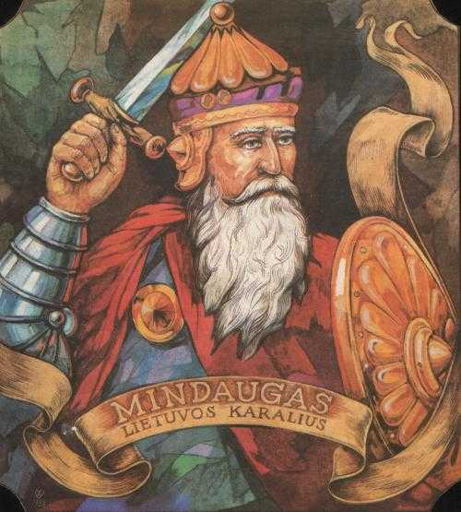
History facts
Lithuanian state was established in 13 th century. The King of Lithuania was Mindaugas. In the 14 th- 15 th centuries Lithuania was the largest and most powerful state in Central Europe.

Slide 8
History facts
Polish-Lithuanian commonwealth, a dualistic state of Poland and Lithuania was established in 1569. Polish-Lithuanian territory was divided by Prussia, Austria and Russia in 18 th century.

Slide 9
History facts
Independence was restored in 1918. Nazi Germany and Soviets signed secret protocols dividing up Lithuania and other independent states in 1939. Lithuania was annexed by the Soviet Union in 1940.

Slide 10
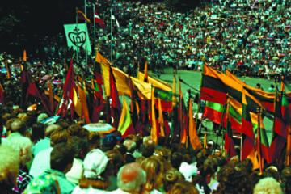
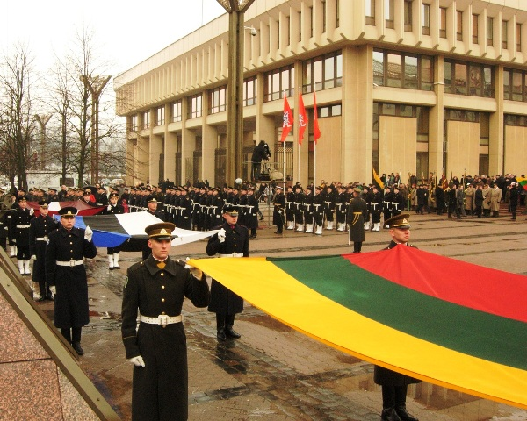
History facts
Lithuania was the first of all the former Soviet republics to break away from the Soviet empire and re-establish independence in 1990.

Slide 11
History facts
In late 2002, Lithuania was accepted for membership in the EU and NATO, and it joined both in 2004.

Slide 12
History curriculum in Lithuania
Students’ knowledge of history
Development of critical thinking
Development of
critical thinking
Understanding of historical development
Students’ comprehension of knowledge of history
Moral values and ways for their acquisition
Areas of history
education
Expression of comprehension
of history
Orientation in time and space
Development of
critical thinking
Development of
critical thinking
Development of common abilities and values
Analysis and interpretation of history

Slide 13
Aim of History Curriculum in Lithuania
PAST
interpretation of the Past;
PRESENT
understanding of the Present;
FUTURE
being aware of his/her identity;
competent use of different historical information in daily life;
to provide perspectives for the change of the society.
development of historical thinking of the students;

Slide 14
Aim of History Curriculum in Lithuania
Development of historical thinking
Comprehension of
Lithuanian citizen and European identity
Comprehension of
the development of Lithuanian society in the context of European history

Slide 15
Differentiation strategy
General principles of differentiation
Respectful tasks
Flexible grouping
Continual assessment
Teacher Differentiates Through:
Content
Process
Product
According to Students’
Readiness
Interest
Learning Profile

Slide 16
Thank you for your attention!

