Slide 1
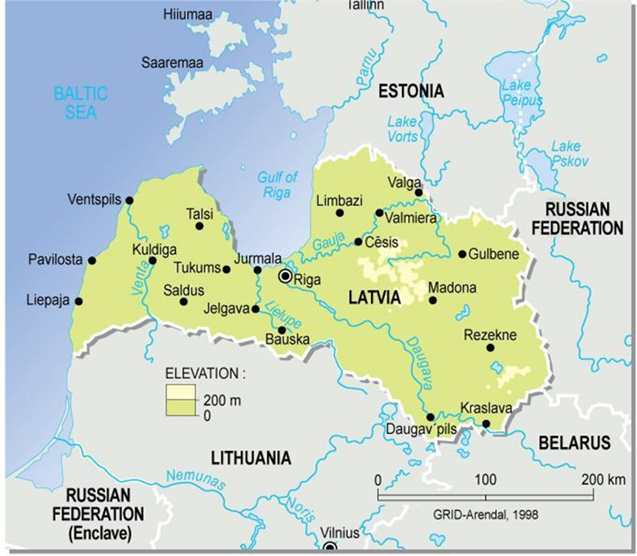
LATVIA, DAUGAVPILS Secondary school of Art Evelina Balode, History and Art history teacher

Slide 2
3 Latvian Historical Landmarks
Until XXth century: dependence on Germany; part of Polish, Swedish, Russian Empires; valuable outcome – multinational population.
Latvia’s independence: 1) from 1918 to 1940 2) from 1991 to present
Latvia’s occupation: 1)June 1940 – June 1941 – occupation by the USSR; 2)June 1941 - summer 1944 – occupation by the Nazi Germany; 3)from1944/45 to 1991- reoccupation by the USSR

Slide 3
History as a school subject in Latvia now...
the tendency to separate Latvian history from the world’s history; 2 different subjects in form 6 since school year 2011/2012;
the reason – to promote patriotism and national self-awareness;
History as a school subject cannot be ‘guilty’ in social problems, economy drawbacks; it cannot be a political weapon.
History gives understanding of varieties in society, unites not separates...
It is not possible to change the past, it is possible to change your own attitude and to influence the future.

Slide 4
One of the objectives of the Ministry of Education and Science programme of History
«To promote the development of democratic person throught the use of the variety of teaching methods at the lessons of History»
Our students are
From multicultural families, some of them have got a low level of Latvian language, but education is in Latvian
Families’ political views, nostalgia about the USSR
Social and economical problems, the wish to immigrate for the seek of better life...

Slide 5
What we do...
educational excursions to real historical places (e.g. Museums, cemeteries, historical buildings, churches, places of historical events, etc.)
reading and analysis of different historical sources the use of ICT
work in groups and class discussions
Thanks for your attention! evelina.balode@inbox.lv

