Slide 1
Italia, Valle d’Aosta Liceo Classico di Aosta Marco Maggi, Ph.D Teacher of History and Philosophy

Slide 2
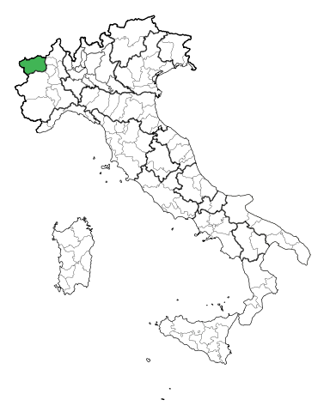
Aosta Valley
2012.23.09 Sun. 15:48

Slide 3
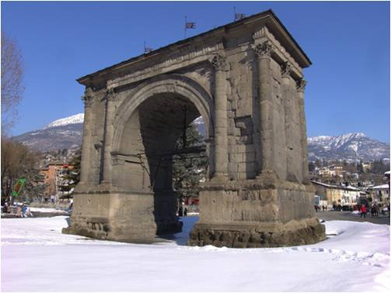
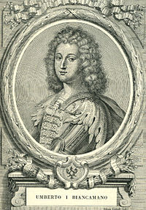
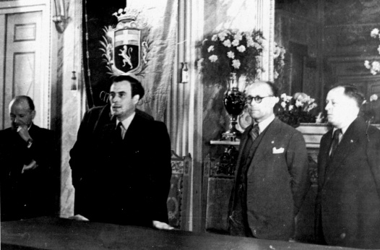
Aosta Valley Historical Landmarks
1032 AD
Erected county under Savoy dynasty
25 BC
Roman conquest under Augustus
1948 AD
Declared autonomous region of the Italian Republic under special statutes

Slide 4
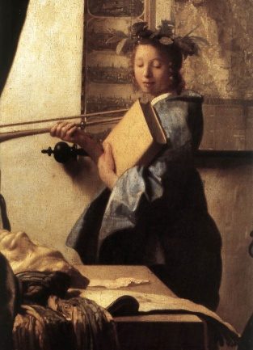
Italy’s History Curriculum Principal Aims
“To know the principal events and long-term transformations of the European and Italian History from ancient times to the present, in the frame of the global history of the world”
“To use properly the language and the interpretative categories of history”
“To be able to read and evaluate different historical sources”
“To be aware of history as a significant dimension for the understanding of the present, through critical discussion and comparison of a variety of perspectives and interpretations”
Source: Indicazioni nazionali, 2010 (http://www.nuovilicei.indire.it)

Slide 5
Italy’s History Curriculum Promoting Historical Understanding
“To understand similarity/continuity and difference/discontinuity elements among different civilizations”
“To know the Italian Constitutional System in comparison with other charters”
“To compare European History with extra-European civilizations”
Source: Indicazioni nazionali, 2010 (http://www.nuovilicei.indire.it)

Slide 6
Teaching History in Aosta Valley
Bilingual (Italian/French) teaching
Double degree system (EsaBac program): European and World History curriculum from a transnational (Italian/French) perspective
(www.vizavi-edu.it)

