Slide 1
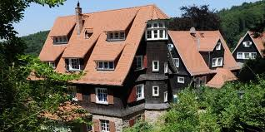
Matthias Fechner, Germany Odenwaldschule Teacher: History, Politics/Economy, German, English Housemaster Head of Department Politics/Economy Academic Liaison Teacher

Slide 2
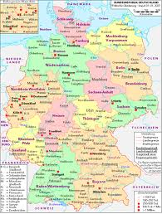
Germany -- Hessen -- Heppenheim -- Odenwaldschule

Slide 3
Heidelberg -- Castle Frankenstein -- Lorsch Monastery Siegfried’s Well

Slide 4
The main aims of Hessen’s history curriculum
Make students understand the present and the future by learning about the past („Die Schülerinnen und Schüler sollen durch die Beschäftigung mit historischen Inhalten und Fragestellungen einsehen, dass vergangenes Geschehen mit ihrer Gegenwart direkt oder indirekt zusammenhängt, sich auf ihr Leben auswirkt und Bedeutung für die Zukunft hat.“ Lehrplan Geschichte Hessen, Gymnasialer Bildungsgang G9, n.d., p. 2)
Help students create a notion of their own identity.
Let students find their own interpretation of history (within the limits of individually and legally defined political correctness).
Further the idea of tolerance towards others.

Slide 5
History Curriculum: promotion of historical understanding in classrooms of mixed abilities and diverse backgrounds
Students can be taught from, at least, 80 different history curricula in Germany
v. Geyr et al. Die europäische Dimension in den Lehrplänen der deutschen Bundesländer (Berlin: Europäische Akademie, 2007), p. 20.
16 federal states x 5 types of school = 80 curricula.
schools may also create their own curriculum or mix curricula (e.g. Realschule until class 10, Gymnasium until class 12/13, comprehensive schools are often using several curricula, according to students‘ abilities; this also applies to schools following a special agenda, e.g. Waldorfschulen or Hermann-Lietz-Schulen; bilingual and binational history may be taught in border areas -- to Poland, France, Belgium, Denmark or the Netherlands).
provided the schools prepare students for statewide central exams.
at Odenwaldschule we use a two-tiered model, i.e. Realschule until class 10, Gymnasium G9 or IGS (Integrative Gesamtschule) until class 13. A school curriculum for classrooms of mixed abilities exists, but is currently not in use.

Slide 6
Odenwaldschule‘s promotion of historical understanding Due to the school‘s past, students have always been confronted with issues and topics of 20th Century history. - alumni have provided eyewitness reports (on the school in the Weimar Republic, the Third Reich and the Bundesrepublik). - students are encouraged to do own research and help with archival work (the archive dates back to the school‘s foundation on 17 April 1910 holding meticulous records and personal correspondence files on almost every student and teacher including members of royal families, children of famous politicians, writers, artists and industrialists). - memorial sites and museums are visited at regular intervals, e.g. Natzweiler, Buchenwald, Dachau, Theresienstadt (Third Reich) or Hohenschönhausen, Speziallager Buchenwald, Bautzen (GDR). - students have created a memorial for an American pilot, Lt. Richard A. Welker, who in 1950 avoided an emergency landing on the school campus and crashed into the forest, instead, where he was killed. - students and teachers are presently preparing a memorial room dedicated to victims of sexual abuse during the school‘s troubled decades (1972 - 1985).

