Slide 1
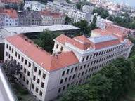
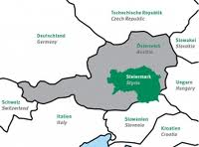
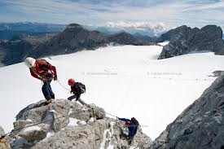
My own background
Helmut Maier
Austria, Styria, Graz
University of Teacher Education Styria
Professor for Didactics and Teaching Methods
Education of teachers for primary schools in didactical matters of German and “Sachunterricht”
Further education for teachers of primary schools

Slide 2
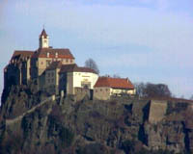
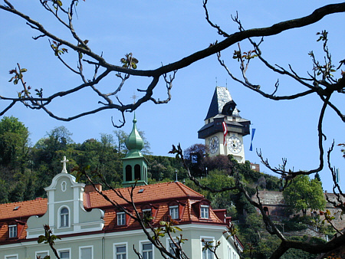
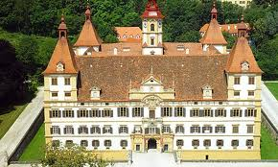
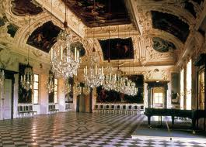
Historical landmarks
Uhrturm
Schloss Eggenberg
Riegersburg

Slide 3
The main aim of the Austrian History Curriculum?
Orientation between the past, the present and future
Children are supposed to get a first unterstanding that developments derives from certain conditions and social circumstances.
Unterstanding of historical, cultural and political development
Historical and political competences

Slide 4
Does your History Curriculum promote historical understanding in classrooms of mixed abilities and diverse backgrounds?
Our curriculum consists of various parts: the general aims, the didactical rules and the single subjects.
The didactical rules demands points like: making the own experiences; teaching has to refer to the pre-concepts of the children; teaching makes individual learning possible

Slide 5
Promotion of historical understanding in classrooms of mixed abilities and diverse backgrounds?
Using methods that makes individual work, individual experiences and referring to the own history possible.
Teaching on various levels, on various topics:
Reducing the claims,
Emotional connection
Providing offers for further learning

