Slide 1
What does it mean to think historically?
Promoting historical understanding in classrooms of mixed abilities and diverse backgrounds and developing channels of communication with the wider community

Slide 2
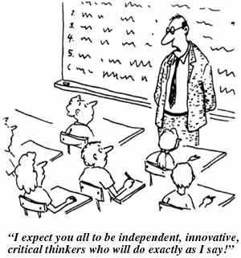

Slide 3
Welcome!
A potted history
  History teacher, head of department, head of humanities faculty, 1989-2004
  Teacher consultant for West Berkshire, 2000-2004
  Lecturer in History Education, University of Southampton, 2001-2011, University of Reading 2011-present
  Member of the Historical Association Secondary Committee since 2001

Slide 4
Council of Europe:
  Multiperspectivity in history module - 2007-2008 (participant);
  THEO project - 2008 (author);
  Education for the Prevention of Crimes against Humanity - 2009-2010 (module leader);
  Teaching history in a changing world - 2011 (joint venture with the Arab League; seminar leader)
  And now here!

Slide 5
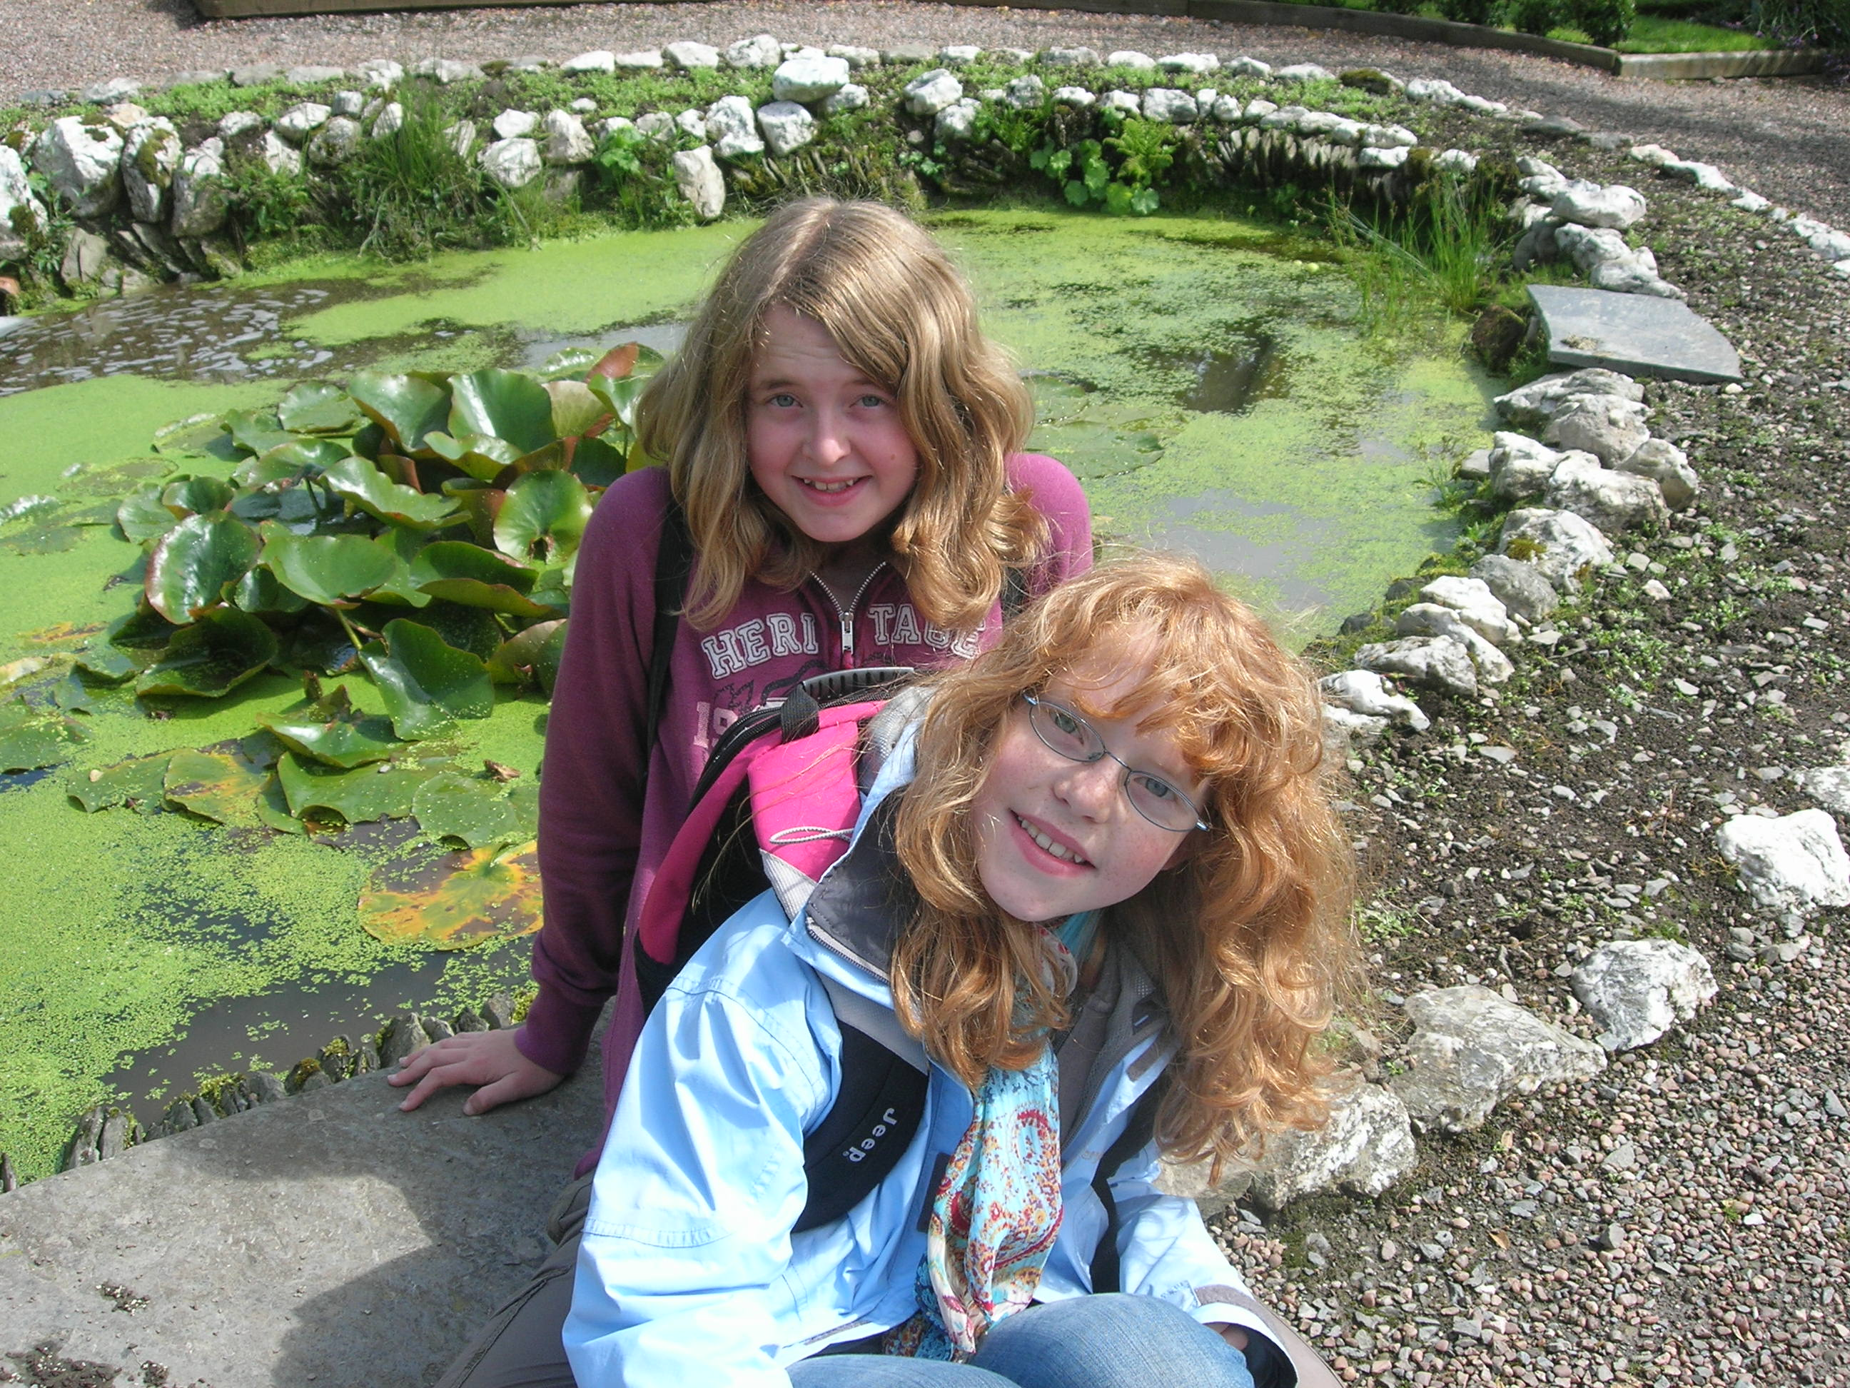
But more importantly ….

Slide 6
The CoE’s values
Democracy
Human rights
Rule of law
Sustainable democratic societies
  environmentally sustainable
  economically sustainable
  societally sustainable!

Slide 7
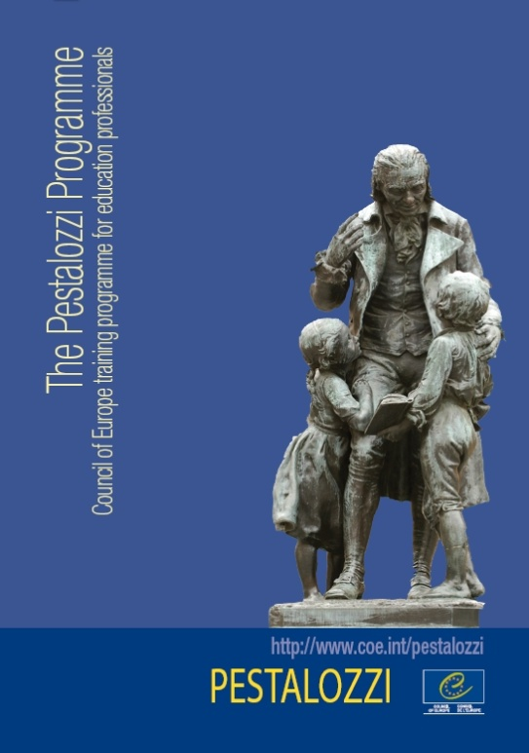
The Pestalozzi Programme
Converging competences
The medium is the message
Teachers matter

Slide 8
What is the Pestalozzi Programme?
What is it?
  Training programme for education professionals
Why Pestalozzi?
  Head, Hand, Heart
What does it offer?
  Training through work together on common concerns trying to elaborate fit solutions for diverse contexts based on shared principles
Who supports it?
  Funds through the budget of the Council of Europe and direct voluntary contributions and indirect contributions in kind mainly from member states

Slide 9
How does the Pestalozzi Programme work?
Main actors
  Council of Europe Education Committee
    Decides
  Network of National Liaison Officers and the Secretariat
    Inform, select, host, organise, disseminate, plan
  Network of trainers
    Facilitate, develop, multiply
  Participating education professionals (you!)
    Exchange, develop, multiply
Programming
  The programme of training activities is prepared on an annual basis
  In cooperation between the Pestalozzi Secretariat, colleagues within the Council of Europe and the National Liaison Officers
Information, communication and documentation platforms
  Public website www.coe.int/pestalozzi
  Online social networks for participants in activities (on invitation only)

Slide 10
Current themes
Education for democratic citizenship and human rights education
Intercultural education and education for linguist and cultural diversity
History education and multiperspectivity
Children’s rights and prevention of violence
Remembrance and the prevention of crimes against humanity
Languages, education of Roma children
Media literacy development
Gender mainstreaming
Collaborative learning
Etc...

Slide 11
Range of activities 1
Training courses
  European Modules of trainer training, 12-18 months
Training events
  European Seminars, 4 days
    Academy of Bad Wildbad, Germany
    European Wergeland Centre, Norway
  European Workshops , 3-4 days
    in the countries party to the European Cultural Convention

Slide 12
Range of activities 2
Targeted cooperation
  Southern Mediterranean (in cooperation with partners such as the Anna-Lindh Foundation)
  Joint Programmes with the European Union; e.g. In Kosovo
  Arab League
Network of trainers
  Further development of the programme and resources
  Developing exchange and collaboration

Slide 13
Modules of trainer training
Working mode
  Collaborative work and peer training
  Focus on practical products and processes and expertise
  Working together over time
Phases of work
  Preparation
  Setting the scene – Module A
  Developing and piloting and exchanging
  Sharing and reflecting on experience – Module B
  Finalising material
  Networking and dissemination
Organisation, selection
  The themes, training teams are selected by the Council of Europe
  The participants are nominated by their national authorities and by partner organisations
  Modules A are organised in Strasbourg
  Modules B are co-organised with and hosted by a member state

Slide 14
Seminars and workshops
European Seminars
  Are organised in cooperation with the Academy of Bad Wildbad and the European Wergeland Centre
  The theme, training team and participants are selected by the Council of Europe and the partner institution
  The participants are education professionals from the member countries and from countries of the southern Mediterranean
European Workshops
  Are organised under the umbrella of the Pestalozzi Programme by and in the member countries
  The Council of Europe selects the Workshop proposals to be included in the programme
  The theme, training team and participants are selected by the organisers
  The participants are education professionals from the host country and from member countries

Slide 15
Social networking and online collaboration
The Pestalozzi Programme uses a free social networking utility “NING”
  Moderated membership on invitation by the Secretariat
  General space for all members and group spaces around specific training activities
Members
  Participants of ongoing training activities (currently only seminars and modules)
  Network of trainers
  Network of National Liaison Officers
Further developments in view
  Interactive databases
  Survey tools
  Documentation centre tools

Slide 16
How can I benefit from the Pestalozzi Programme?
Find information
  About ongoing activities and their results on the Pestalozzi Programme website
Find resources
  Reading
  Reflection
  Teaching
  Training
Participate
  in a Pestalozzi training activity
  In a trainer training course
  Answer the Call for trainers
  in networking and disseminating in your country
Contact
  the Pestalozzi Liaison Officer in your country
  The Pestalozzi Secretariat at the Council of Europe

Slide 17
Let’s get you thinking!
What/who has influenced your teaching/work?
For me:
  History – Christine Counsell, Michael Riley, SHP approach
  Teaching and learning – social constructivist theories (Vygotsky), group work/exploratory talk (Neil Mercer)
  Teacher development – Fred Korthagen, action research, Critical Race Theory

Slide 18
Individual reflection
  What/who has influenced your teaching/work?
Group discussion
  Share your ideas
  What similarities and differences are there between your influences?

Slide 19
Why does this matter?
Need to be aware of own position before we can be openly reflective and critical
Helps us understand why we embrace some ideas and become defensive with other ideas

Slide 20
The challenge of taking on new ideas
Teachers change beliefs only if they are challenged and appear unsatisfactory. Even then ... they change beliefs only as a last alternative. Cabello, B. and Burstein, N. D. (1995) ‘Examining Teachers’ Beliefs about Teaching in Culturally Diverse Classrooms’ Journal of Teacher Education 46 (4), 285-294
Beliefs that are held particularly strongly may furthermore function as a source of conservatism in schools and as friction in teacher education, because the entrants to teacher education have often been good students in traditional schools and successful in teacher-driven instruction, and therefore unwilling to change their beliefs. Virta, A. (2002) ‘Becoming a History Teacher: Observations on the Beliefs and Growth of Student Teachers’. Teaching and Teacher Education 18 (6), 687-698

Slide 21
Teacher educators appear to be faced with an almost impossible task. Not only do students teachers show a strong resistance to attempts to change their existing preconceptions, but these preconceptions also serve as filters in making sense of theories and experiences in teacher education. Korthagen, F. A. J., Kessels, J., Koster, B., Lagerwerf, B. and Wubbels, T. (2001) Linking Theory and Practice: the pedagogy of realistic teacher education. Mahwah, New Jersey: Lawrence Erlbaum Associates
Recent studies concerned with educational innovation have ... shown the majority of innovations to fail because the teachers – even after a considerable period of time and change – simply abandon the new behaviour and return to comfortable old routines. Van Eekelen, I.M., Vermunt, J.D. and Boshuizen, H.P.A. (2006) ‘Exploring teachers’ will to learn’ Teaching and Teacher Education 22, 408-423

Slide 22
A question of pedagogy
Triggers of learning
  Challenge to ideas and practices
  Experience new ideas and practices
  Reflection on experiences, ideas and practices
Facilitation of learning
  Collaborative knowledge construction
  Learning by doing
  Interactive and peer-centred
How we teach matters - The medium is the message

Slide 23
What are you hoping to achieve/gain from this workshop?
Individual reflection
Group discussion
  Share your ideas
  What similarities and differences are there between your hopes?
Consider how you will get the most out of this workshop a) whilst you are here b) when you return home?

Slide 24
So what next?
This will depend upon your position within your organisation
Think about
  Personal practice?
  Collaborative practice within the group?
  School practice?
  National practice?
  International practice?
  Further CoE participation – workshops, seminars, module series?

