Slide 1
Δυο διεθνή παραδείγματα συνδυασμένης εκπαίδευσης STEM στο δευτεροβάθμιο επίπεδο σπουδών
Stamatis Vokos Professor of Physics and STAR Director

Slide 2
How we think of STEM Matters
If the different disciplines (physics, chemistry, biology, earth and space science, engineering, technology, mathematics) are like fruit, is STEM more like
A smoothie?
A fruit salad?
The answer guides program development.

Slide 3
Next Generation Science Standards
Three-dimensional learning
Disciplinary Core Ideas
Crosscutting Concepts
Science and Engineering Practices

Slide 4
From inquiry-based learning to 3-d learning
In the US, inquiry lost any operationalization. Worse, it became a separate, independent learning target from the important science ideas.
NGSS: Science and Engineering Practices (SEPs) are interwoven with DCIs and CCCs:
SEP 1: Asking questions (for science) and defining problems (for engineering) SEP 2: Developing and using models SEP 3: Planning and carrying out investigations SEP 4: Analyzing and interpreting data SEP 5: Using mathematics and computational thinking SEP 6: Constructing explanations (for science) SEP 6: Designing solutions (for engineering) SEP 7: Engaging in argument from evidence SEP 8: Obtaining, evaluating, and communicating information

Slide 5
Next Generation Science Standards
Three-dimensional learning
Disciplinary Core Ideas
Crosscutting Concepts
Science and Engineering Practices
Example of performance expectations:
HS-PS3-3. Design, build, and refine a device that works within given constraints to convert one form of energy into another form of energy.* [Clarification Statement: Emphasis is on both qualitative and quantitative evaluations of devices. Examples of devices could include Rube Goldberg devices, wind turbines, solar cells, solar ovens, and generators. Examples of constraints could include use of renewable energy forms and efficiency.] [Assessment Boundary: Assessment for quantitative evaluations is limited to total output for a given input. Assessment is limited to devices constructed with materials provided to students.]

Slide 6
Engineering Design Process

Slide 7
Identify Problem or Need
Communicate
Research Solutions
Engineering
Design
Process
Construct a Prototype. Test, Evaluate & Redesign
Identify Design Requirements
Develop Possible Solutions

Slide 8
Two examples
Egypt’s STESSA project
STEM high schools
Paso Robles HS

Slide 9
Egypt’s STESSA Project

Slide 14
Example: Climate Change (in Cyprus)
The Minister of Education has come to your school. They have heard that you and your colleagues have developed a transdisciplinary course that addresses some aspects of climate change. What would you say (during an elevator ride) is the driving issue of the course? Why should a Cypriot student be interested in this course? How is the course different than the other science/math courses they could be taking?
Talk to your neighbor(s).

Slide 16
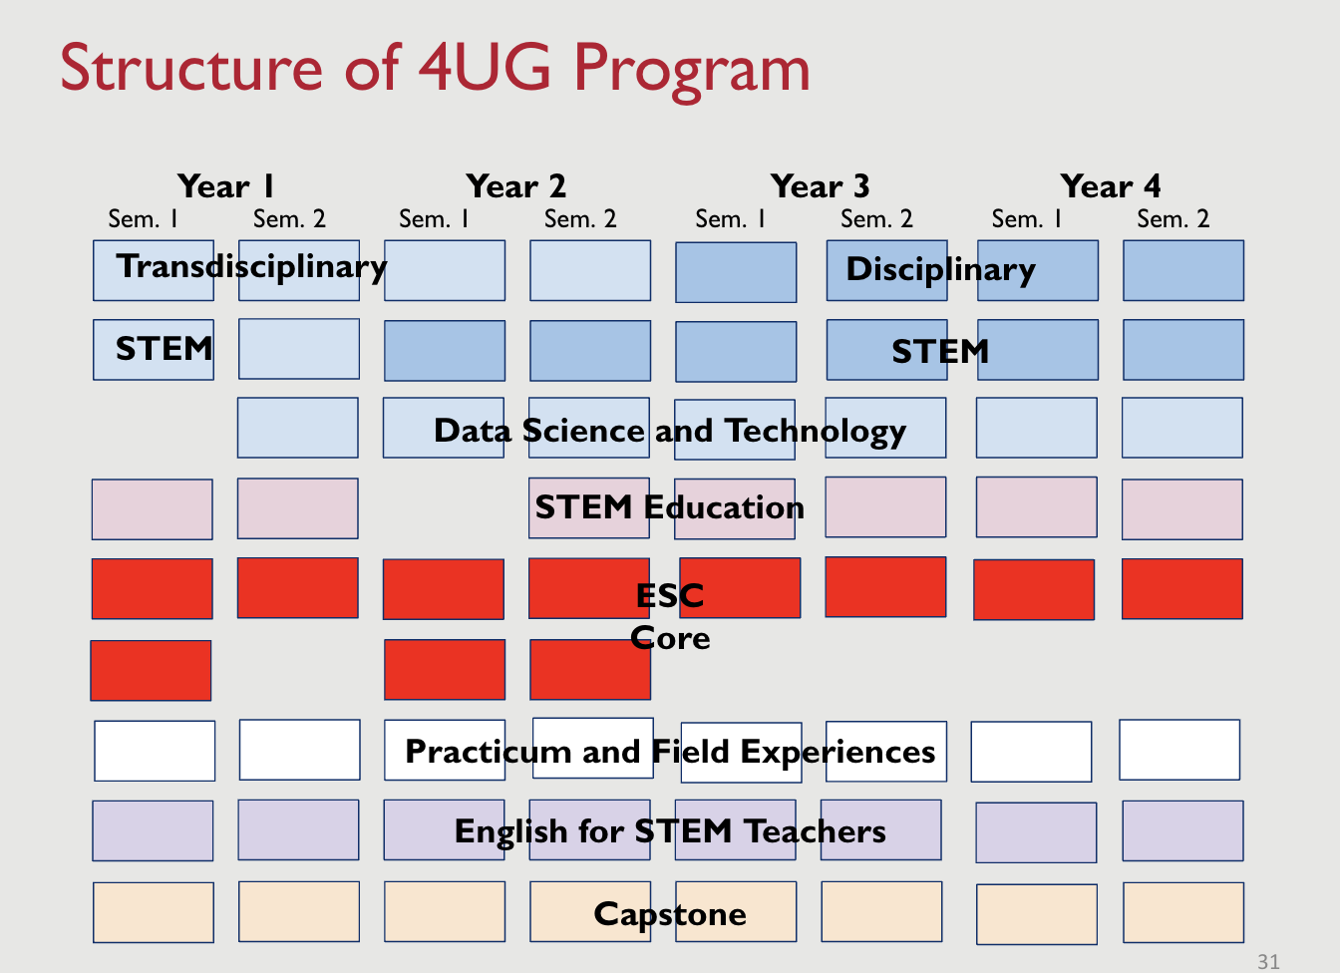

Slide 17
Capstone product examples

Slide 18
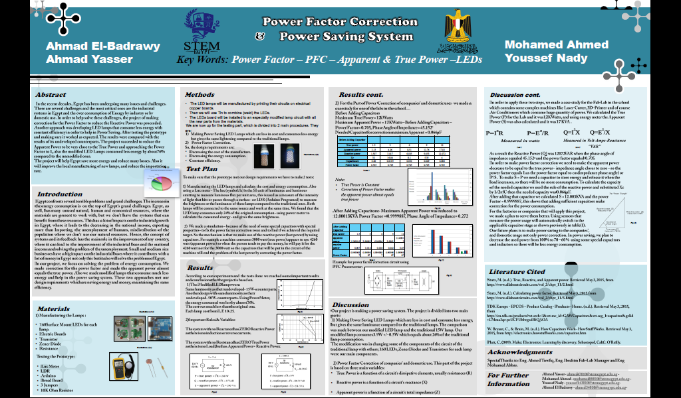

Slide 19
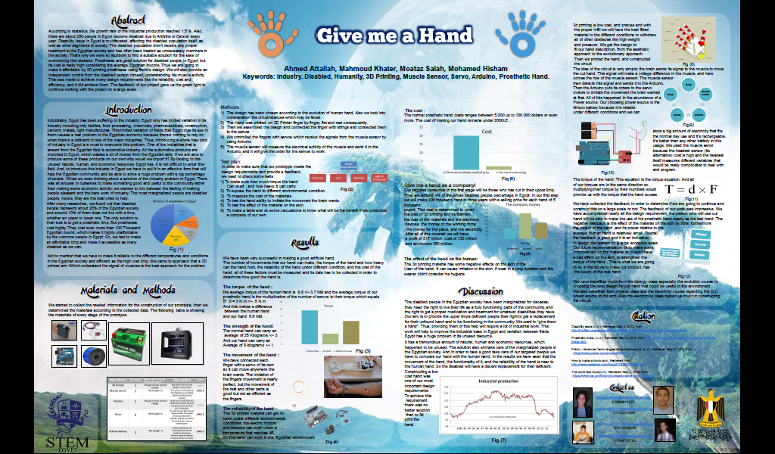

Slide 20
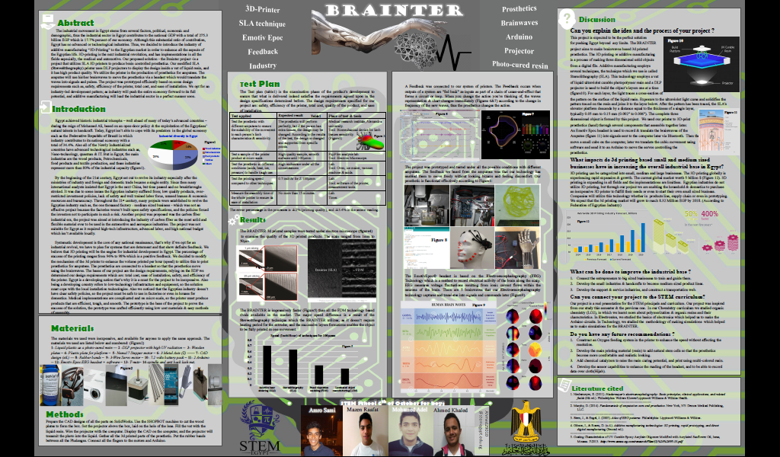

Slide 22
STEM Schools in USA: Paso Robles HS
Core integrated science classes for all students in the last four years of HS:
Science Academy I
Science Academy II
Science Academy III
(These are in addition to Advanced Placement courses, Honors versions of these courses, field-based opportunities, etc.)

Slide 23
Summary
Models of STEM education need to attend to:
Intellectual Coherence
Depth rather than breadth
Students’ interests, students’ prior ideas, students’ need-to-know
Integration of practices and habits of mind of the disciplines, and not just disciplinary concepts
Authentic opportunities for students to communicate to the community what they have learned and can do

Slide 24
What are your comments/questions?
svokos@calpoly.edu

